Slide 1
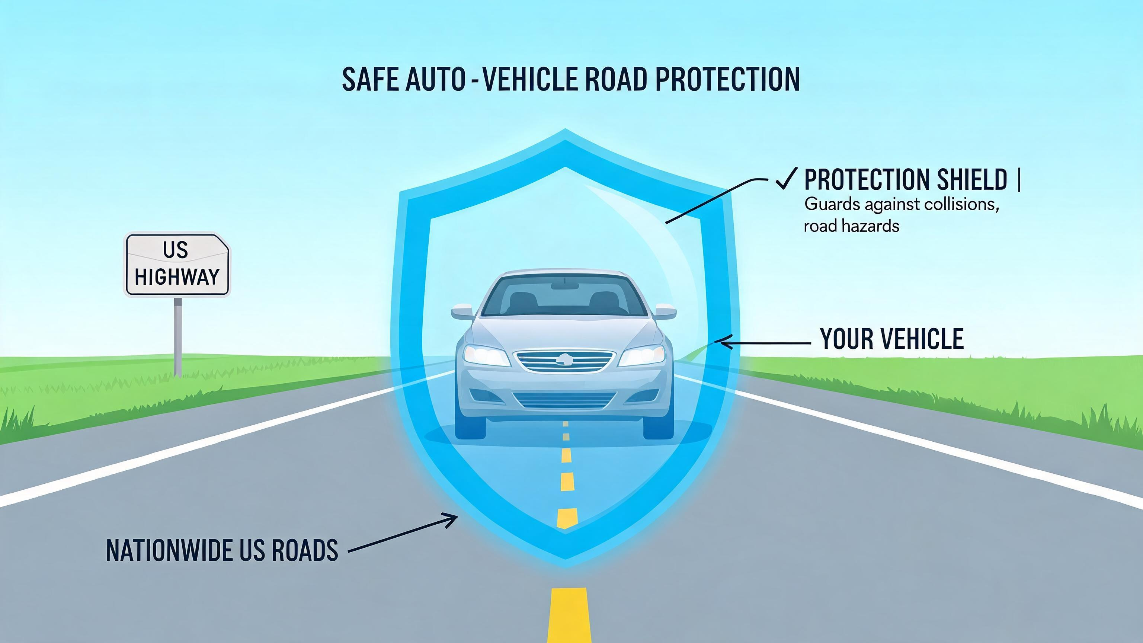
Welcome to Auto Insurance 101
An overview of why auto insurance is mandatory in the US and what we will cover.
Legal requirements by state
Financial protection against accidents
The concept of shared risk
Notes:
Good morning, everyone, and welcome. Today, we're starting Auto Insurance 101—a foundational guide to understanding why auto insurance is not just a piece of paper, but a critical part of financial responsibility in the United States. I'm Richard, and I'll be guiding you through this material. We're going to break down exactly why coverage is mandatory and what risks it protects you from. By the end of this course, terms like premium, deductible, and liability won't just be jargon—they'll be tools you can use to make smart decisions. First, let's look at the legal landscape. Almost every state requires you to prove financial responsibility, meaning you must have a minimum level of liability insurance to legally drive. This varies from state to state, but the core principle is the same: you must be able to pay for damages you cause. This brings us to the second major reason: financial protection. An accident can be devastatingly expensive, with costs easily reaching tens of thousands of dollars from medical bills and property damage. Insurance acts as a shield, protecting your savings and your future earnings. And this entire system is built on the concept of shared risk. Many people pay relatively small premiums into a pool, and that pool is used to cover the large, unexpected losses of the few. You're not just paying for yourself; you're part of a collective safety net. We'll explore each of these topics in detail, starting right now.

Slide 2

Summary & Smart Shopping
Final tips on how to shop for insurance and maintain your coverage.
1
Compare quotes every 6-12 months
2
Bundle with home or renters insurance
3
Importance of never letting coverage lapse
Notes:
We've covered a lot of ground today in Auto Insurance 101. Let's wrap up with some final, actionable tips for smart shopping and maintaining your policy. This is your toolkit for becoming a savvy consumer. My number one piece of advice: treat insurance like a subscription you audit. Make it a habit to compare quotes every six to twelve months. Insurers change their pricing models constantly, and loyalty doesn't always pay. What was the best deal last year might not be the best deal today. Second, always ask about bundling. Combining your auto insurance with a home, condo, or renters policy from the same company can unlock significant discounts—often between 10% and 25%. It's one of the simplest ways to save, and it conveniently puts all your most important protections in one place. And this final point is absolutely crucial: never, ever let your coverage lapse. A gap in coverage, even for a single day, marks you as a high-risk driver to future insurers and will cause your premiums to skyrocket. It’s a financial scar that takes years to heal. If you’re switching companies, make sure the new policy starts before the old one ends. To recap our session: we dissected the anatomy of a policy, explored the impact of deductibles and liability limits, ran through some rate factors, and navigated an accident scenario. The core takeaway is that insurance isn't just a mandatory bill; it's a financial shield that you can and should manage intelligently. Approach it with the same diligence as any other major financial decision. Thank you for your excellent questions and energy today, everyone. You're now better equipped to protect yourself and your assets on the road. Drive safely, and shop smart!

